Slide 1
Understanding data leakage in cloud from Mobile Apps
-Devin Lilaramani, Shriya Surusani, Anoop Kakkireni.

Slide 2
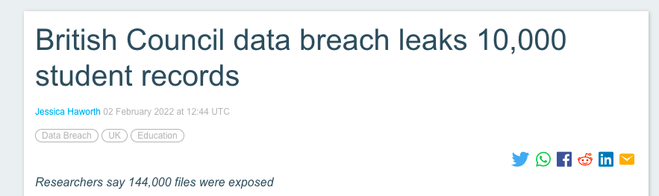

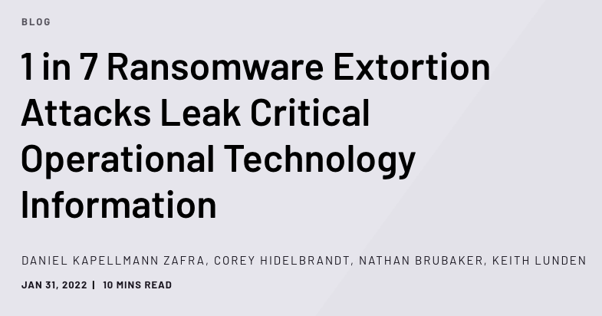

Introduction
Data Leak in today’s world

Slide 3
Problem Statement
Why data leaks occur and how to automatically identify them?
Identification of various keys used by mobile apps
Develop an approach to extract relevant key strings of our interest
Design a verification method with zero data leakage to validate the possibility of a data leak

Slide 4
Research Style
Measuring the current status/impact of a known security threat
-Third research style
-Measuring the current impact of a known security threat
-Main reference: “Why Does Your Data Leak? Uncovering the Data Leakage in Cloud from Mobile Apps”

Slide 5
Related Work
Vulnerability identification in mobile apps
TaintDroid [1], PiOS [2], and AndroidLeaks [3] focused on privacy leakage such as GPS coordinates and address book.
CHEX [4] and Harehunter [5] have been developed to identify component and code hijacking vulnerabilities
ConfErr [6], ConfAid [7] and SPEX[8] are configuration testing tools to reveal misconfigurations and improper authorizations.

Slide 6
Plan of Progress
Code execution and code understanding.
Getting the sample set of Mobile apps using AWS or Azure or Firebase.
Checkpoint: 1

Slide 7
Plan of Progress
Check which cloud Mbaas service the app is using.
Get the key from the app manually, dynamically.
Checkpoint: 2

Slide 8
Plan of Progress
Check if the key is root key or app key and check if the mobile app could causes the data leakage.
Check for authorization.
Checkpoint: 3

Slide 9
References
[1] W. Enck, P. Gilbert, B. Chun, L. Cox, J. Jung, P. McDaniel, and A. Sheth, “TaintDroid: an information-flow tracking system for realtime privacy monitoring on smartphones,” in OSDI, 2010
[2] M. Egele, C. Kruegel, E. Kirda, and G. Vigna, “Pios: Detecting privacy leaks in ios applications,” in NDSS, 2011.
[3] C. Gibler, J. Crussell, J. Erickson, and H. Chen, “Androidleaks: automatically detecting potential privacy leaks in android applications on a large scale,” in Trust, 2012.
[4] L. Lu, Z. Li, Z. Wu, W. Lee, and G. Jiang, “Chex: statically vetting android apps for component hijacking vulnerabilities,” in Proceedings of the 2012 ACM conference on Computer and communications security. ACM, 2012, pp. 229–240.
[5] Y. Aafer, N. Zhang, Z. Zhang, X. Zhang, K. Chen, X. Wang, X. Zhou, W. Du, and M. Grace, “Hare hunting in the wild android: A study on the threat of hanging attribute references,” in Proceedings of the 22nd ACM SIGSAC Conference on Computer and Communications Security. ACM, 2015, pp. 1248–1259.
[6] L. Keller, P. Upadhyaya, and G. Candea, “Conferr: A tool for assessing resilience to human configuration errors,” in Dependable Systems and Networks With FTCS and DCC, 2008. DSN 2008. IEEE International Conference on. IEEE, 2008, pp. 157–166.
[7] M. Attariyan and J. Flinn, “Automating configuration troubleshooting with dynamic information flow analysis,” in Proceedings of the 9th USENIX Conference on Operating Systems Design and Implementation, ser. OSDI’10, Vancouver, BC, Canada, 2010, pp. 237–250.
[8] T. Xu, J. Zhang, P. Huang, J. Zheng, T. Sheng, D. Yuan, Y. Zhou, and S. Pasupathy, “Do not blame users for misconfigurations,” in Proceedings of the Twenty-Fourth ACM Symposium on Operating Systems Principles, ser. SOSP ’13, Farminton, Pennsylvania, 2013, pp. 244–259.

Slide 10
Thankyou (:

